Slide 1
ICT 기술 연구 트렌드
International Conference를 중심으로
20132605 안상준
20155186 김현지
Notes:
44 / 18

Slide 2
연구 트렌드 목차
서론
연구 배경
데이터 소스 사이트
본론
작업 흐름도
데이터 사이트 구조 및 노드
데이터 처리 결과
시각화
결론
결과 해석
Q&A
Notes:
36 / 24 / 16

Slide 3
서론
연구 배경에 대하여
데이터 소스 사이트
Notes:
44/ 15

Slide 4
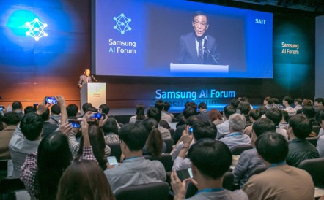
연구 배경
주제를 선정하게 된 배경
최근 NN, CV, ML과 같은
ICT 기술 관심도 증가
다양한 Conference의 논문을 수집해보자!

Slide 5

데이터 소스
주제와 관련된 데이터 소스 추출 사이트
CVPR Conference
NIPS Conference
ICML Conference
Computer Vision
Pattern Recognition
Neural Information
Processing Systems
Internation Conference on Machine Learning
Notes:
5. Explanation about conference : nips, icml, cvpr

Slide 6
분석 과정
데이터 수집부터 데이터 분석까지

Slide 7
작업 흐름도
전반적인 데이터 분석 흐름도
Html 문서로 되어 있는
각 사이트 별 DOM 트리 계층 구조로 파싱
다양한 함수를 이용하여
원하는 데이터를
정제하여 추출
Word Frequency 기반 다양한 시각화
HTML Parsing
Scraping
Visualization
URL
Extract Node
Download Paper
각 사이트 별 URL을
URL 변수에 저장 후,
getURL 함수 이용해
사이트 URL 저장
DOM 트리 구조로 파싱 후,
목표 데이터 노드 위치를
파악하여 노드 추출
각 사이트 별 URL을 이용해 PDF 파일로
논문 파일 저장 및 이용
Notes:
6. Work flow

Slide 8
web_scraping(working_directory, name, number)
웹 스크레이핑 통합 함수생성 (작업 공간, 컨퍼런스 명, 논문 개수)
논문 명에 해당되는 노드로 접근하여
데이터 추출 및 저장
논문 내용을 담고 있는 링크를 접속하여 pdf파일로 변환 및 저장
추출된 내용을
Rdata로 저장
Paper_Name
Paper_Contents
RData
Name
Writer
Preprocess
컨퍼런스 명 지정 시, 해당 컨퍼런스의 링크를 지정
논문 작성자에 해당되는 노드로 접근하여
데이터 추출 및 저장
대 소문자 통합, 숫자, 문장부호 제거
Notes:
6. Work flow

Slide 9
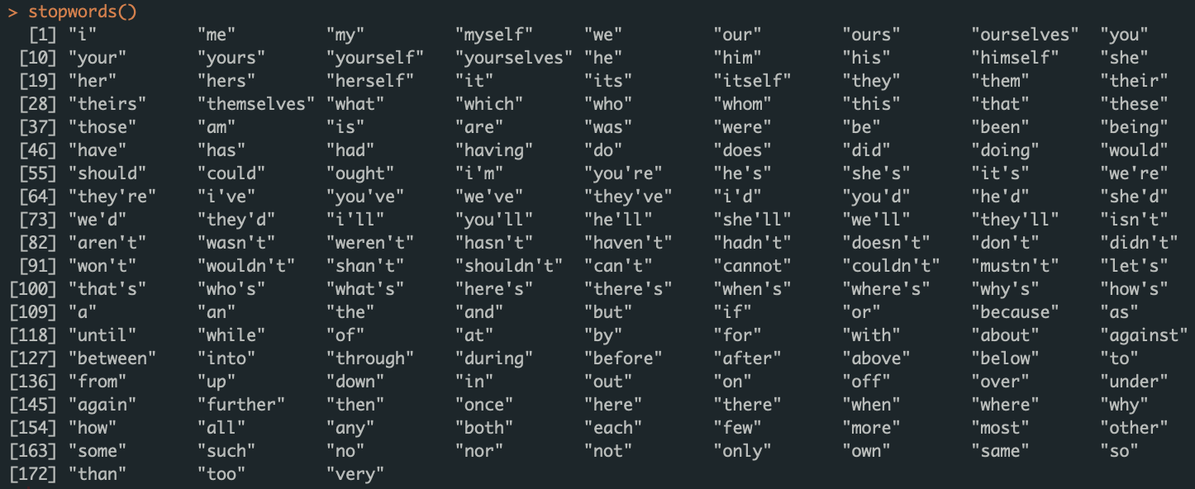
[CVPR]
CVPR_Paper_Contents : 논문 내용
CVPR_Paper_Name : 논문 명
CVPR_Writer : 논문 저자
CVPR_Word_Before :논문 내용 단어 (불용어 제거 전) 불용어 사전 (in tm package)
CVPR_Word_After : 논문 내용 단어 (불용어 제거 후)
[NIPS]
NIPS_Paper_Contents : 논문 내용
NIPS_Paper_Name : 논문 명
NIPS _Writer : 논문 저자
NIPS _Word_Before :논문 내용 단어 (불용어 제거 전)
NIPS _Word_After : 논문 내용 단어 (불용어 제거 후)
[ICML]
ICML_Paper_Contents : 논문 내용
ICML _Paper_Name : 논문 명
ICML _Writer : 논문 저자
ICML _Word_Before :논문 내용 단어 (불용어 제거 전)
ICML _Word_After : 논문 내용 단어 (불용어 제거 후)
web_scraping(working_directory, name, number)
웹 스크레이핑 통합 함수생성 (작업 공간, 컨퍼런스 명, 논문 개수)
논문 명에 해당되는 노드로 접근하여
데이터 추출 및 저장
논문 내용을 담고 있는 링크를 접속하여 pdf파일로 변환 및 저장
추출된 내용을
Rdata로 저장
Paper_Name
Paper_Contents
RData
name
Writer
Preprocess
컨퍼런스 명 지정 시, 해당 컨퍼런스의 링크를 지정
논문 작성자에 해당되는 노드로 접근하여
데이터 추출 및 저장
대 소문자 통합, 숫자, 문장부호 제거
Notes:
6. Work flow

Slide 10
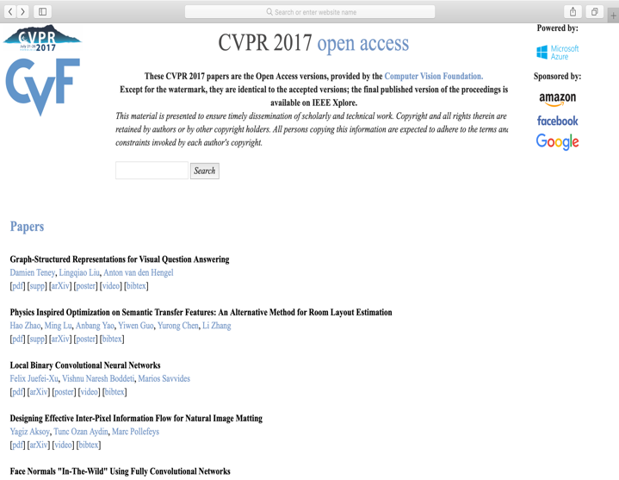
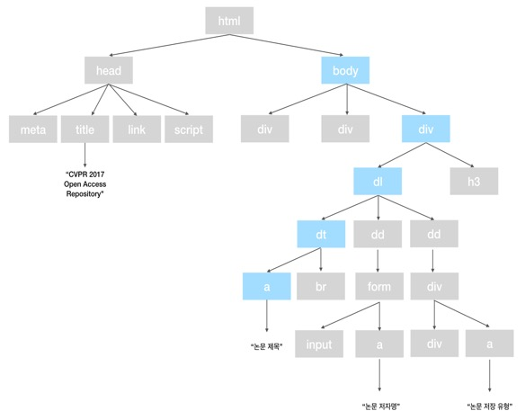
데이터 구조
CVPR(Computer Vision Pattern Recognition)
url <- "http://openaccess.thecvf.com/CVPR2017.py"
html <- getURL(url)
html.parsed <- htmlParse(html)
# Paper Name
CVPR_Paper_Name <- xpathSApply(doc = html.parsed, path = "//dt/a", fun = xmlValue)
CVPR_Paper_Name <- gsub(pattern = "[[:punct:]]", replacement = " ", CVPR_Paper_Name)
save(CVPR_Paper_Name, file = "CVPR_Paper_Name.RData")

Slide 11
데이터 구조
<div class="link2">[<a class="fakelink" onclick="$(this).siblings('.bibref').slideToggle()">bibtex</a>]
<div class="bibref">
@InProceedings{Ramanishka_2017_CVPR,<br>
author = {Ramanishka, Vasili and Das, Abir and Zhang, Jianming and Saenko, Kate},<br>
title = {Top-Down Visual Saliency Guided by Captions},<br>
booktitle = {The IEEE Conference on Computer Vision and Pattern Recognition (CVPR)},<br>
month = {July},<br>
year = {2017}<br>
}
</div>
</div>
</dd>
<dt class="ptitle">
<br><a href="content_cvpr_2017/html/Tsai_The_Geometry_of_CVPR_2017_paper.html">The Geometry of First-Returning Photons for Non-Line-Of-Sight Imaging</a>
</dt>
<dd>
<form id="form-Chia-YinTsaiTheGeometryof" action="./CVPR2017_search.py" method="post" class="authsearch">
<input type="hidden" name="query" value="Chia-Yin Tsai"><a href="#" onclick="document.getElementById('form-Chia-YinTsaiTheGeometryof').submit();">Chia-Yin Tsai</a>,
</form>
추출 및 처리 결과
[1] "Graph Structured Representations for Visual Question Answering"
[2] "Physics Inspired Optimization on Semantic Transfer Features An Alternative Method for Room Layout Estimation"
[3] "Local Binary Convolutional Neural Networks"
[4] "Designing Effective Inter Pixel Information Flow for Natural Image Matting"
[5] "Face Normals In The Wild Using Fully Convolutional Networks"
[6] "3D Face Morphable Models In The Wild "
CVPR(Computer Vision Pattern Recognition)
url <- "http://openaccess.thecvf.com/CVPR2017.py"
html <- getURL(url)
html.parsed <- htmlParse(html)
# Paper Name
CVPR_Paper_Name <- xpathSApply(doc = html.parsed, path = "//dt/a", fun = xmlValue)
CVPR_Paper_Name <- gsub(pattern = "[[:punct:]]", replacement = " ", CVPR_Paper_Name)

Slide 12
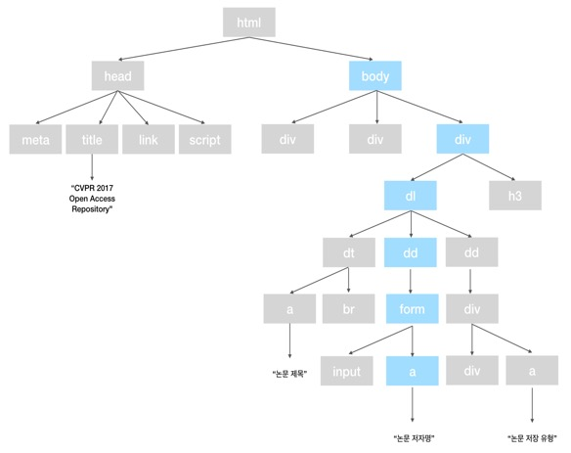
데이터 구조
CVPR(Computer Vision Pattern Recognition)
CVPR_Writer <- xpathSApply(doc = html.parsed, path = "//div/dl/dd", fun = xmlValue)
CVPR_Writer <- CVPR_Writer[seq(1, length(CVPR_Writer), 2)]
CVPR_Writer <- gsub(pattern = "\n", replacement = "", x = CVPR_Writer)
CVPR_Writer <- strsplit(x = CVPR_Writer, split = ",")
save(CVPR_Writer, file = "CVPR_Writer.RData")

Slide 13
데이터 구조
<div class="link2">[<a class="fakelink" onclick="$(this).siblings('.bibref').slideToggle()">bibtex</a>]
<div class="bibref">
@InProceedings{Ramanishka_2017_CVPR,<br>
author = {Ramanishka, Vasili and Das, Abir and Zhang, Jianming and Saenko, Kate},<br>
title = {Top-Down Visual Saliency Guided by Captions},<br>
booktitle = {The IEEE Conference on Computer Vision and Pattern Recognition (CVPR)},<br>
month = {July},<br>
year = {2017}<br>
}
</div>
</div>
</dd>
<dt class="ptitle">
<br><a href="content_cvpr_2017/html/Tsai_The_Geometry_of_CVPR_2017_paper.html">The Geometry of First-Returning Photons for Non-Line-Of-Sight Imaging</a>
</dt>
<dd>
<form id="form-Chia-YinTsaiTheGeometryof" action="./CVPR2017_search.py" method="post" class="authsearch">
<input type="hidden" name="query" value="Chia-Yin Tsai"><a href="#" onclick="document.getElementById('form-Chia-YinTsaiTheGeometryof').submit();">Chia-Yin Tsai</a>,
</form>
추출 및 처리 결과
[[1]]
[1] "Damien Teney" "Lingqiao Liu" "Anton van den Hengel"
[[2]]
[1] "Hao Zhao" "Ming Lu" "Anbang Yao" "Yiwen Guo" "Yurong Chen" "Li Zhang"
[[3]]
[1] "Felix Juefei-Xu" "Vishnu Naresh Boddeti" "Marios Savvides"
[[4]]
[1] "Yagiz Aksoy" "Tunc Ozan Aydin" "Marc Pollefeys"
[[5]]
[1] "George Trigeorgis" "Patrick Snape" "Iasonas Kokkinos" "Stefanos Zafeiriou"
[[6]]
[1] "James Booth" "Epameinondas Antonakos" "Stylianos Ploumpis" "George Trigeorgis"
[5] "Yannis Panagakis" "Stefanos Zafeiriou"
CVPR(Computer Vision Pattern Recognition)
CVPR_Writer <- xpathSApply(doc = html.parsed, path = "//div/dl/dd", fun = xmlValue)
CVPR_Writer <- CVPR_Writer[seq(1, length(CVPR_Writer), 2)]
CVPR_Writer <- gsub(pattern = "\n", replacement = "", x = CVPR_Writer)
CVPR_Writer <- strsplit(x = CVPR_Writer, split = ",")

Slide 14
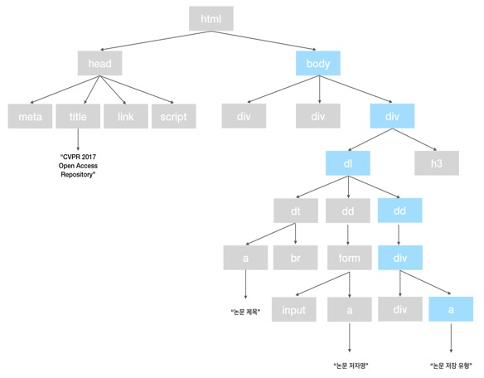
데이터 구조
CVPR(Computer Vision Pattern Recognition)
CVPR_Paper <- xpathSApply(doc = html.parsed, path = "//dd/a[1]", fun = xmlAttrs, "href")
CVPR_URL <- paste0("http://openaccess.thecvf.com/", CVPR_Paper)

Slide 15
데이터 구조
<div class="link2">[<a class="fakelink" onclick="$(this).siblings('.bibref').slideToggle()">bibtex</a>]
<div class="bibref">
@InProceedings{Ramanishka_2017_CVPR,<br>
author = {Ramanishka, Vasili and Das, Abir and Zhang, Jianming and Saenko, Kate},<br>
title = {Top-Down Visual Saliency Guided by Captions},<br>
booktitle = {The IEEE Conference on Computer Vision and Pattern Recognition (CVPR)},<br>
month = {July},<br>
year = {2017}<br>
}
</div>
</div>
</dd>
<dt class="ptitle">
<br><a href="content_cvpr_2017/html/Tsai_The_Geometry_of_CVPR_2017_paper.html">The Geometry of First-Returning Photons for Non-Line-Of-Sight Imaging</a>
</dt>
<dd>
<form id="form-Chia-YinTsaiTheGeometryof" action="./CVPR2017_search.py" method="post" class="authsearch">
<input type="hidden" name="query" value="Chia-Yin Tsai"><a href="#" onclick="document.getElementById('form-Chia-YinTsaiTheGeometryof').submit();">Chia-Yin Tsai</a>,
</form>
추출 및 처리 결과
[1] "http://openaccess.thecvf.com/content_cvpr_2017/papers/Teney_Graph-Structured_Representations_for_CVPR_2017_paper.pdf"
[2] "http://openaccess.thecvf.com/content_cvpr_2017/papers/Zhao_Physics_Inspired_Optimization_CVPR_2017_paper.pdf"
[3] "http://openaccess.thecvf.com/content_cvpr_2017/papers/Juefei-Xu_Local_Binary_Convolutional_CVPR_2017_paper.pdf"
[4] "http://openaccess.thecvf.com/content_cvpr_2017/papers/Aksoy_Designing_Effective_Inter-Pixel_CVPR_2017_paper.pdf"
[5] "http://openaccess.thecvf.com/content_cvpr_2017/papers/Trigeorgis_Face_Normals_In-The-Wild_CVPR_2017_paper.pdf"
[6] "http://openaccess.thecvf.com/content_cvpr_2017/papers/Booth_3D_Face_Morphable_CVPR_2017_paper.pdf"
[7] "http://openaccess.thecvf.com/content_cvpr_2017/papers/Adhikarla_Towards_a_Quality_CVPR_2017_paper.pdf"
[8] "http://openaccess.thecvf.com/content_cvpr_2017/papers/Kotaru_Position_Tracking_for_CVPR_2017_paper.pdf"
CVPR(Computer Vision Pattern Recognition)
CVPR_Paper <- xpathSApply(doc = html.parsed, path = "//dd/a[1]", fun = xmlAttrs, "href")
CVPR_URL <- paste0("http://openaccess.thecvf.com/", CVPR_Paper)

Slide 16
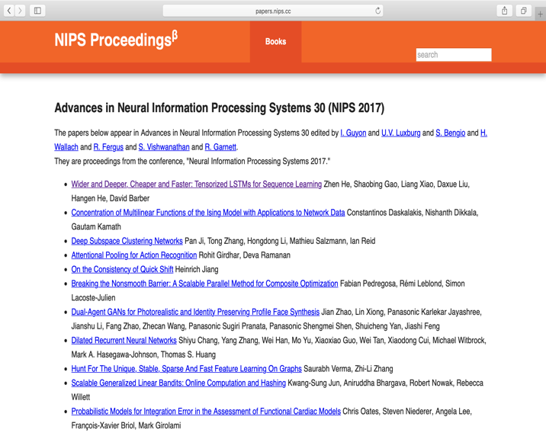
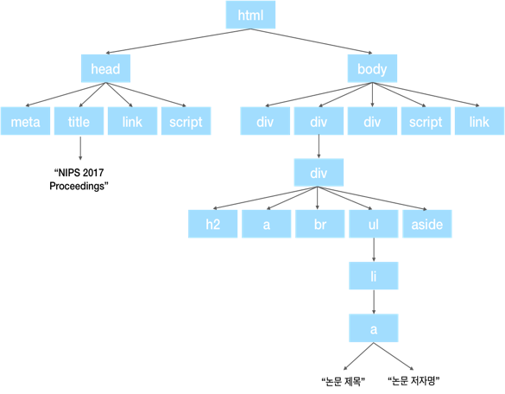
데이터 구조
NIPS(Neural Information Precessing System.)
url <- "http://papers.nips.cc/book/advances-in-neural-information-processing-systems-30-2017"
html <- getURL(url)
html.parsed <- htmlParse(html)
# Paper Name
NIPS_Paper_Name <- xpathSApply(doc = html.parsed, path = "//div/ul/li/a[1]", fun = xmlValue)
NIPS_Paper_Name <- gsub(pattern = "[[:punct:]]", replacement = " ", NIPS_Paper_Name)
save(NIPS_Paper_Name, file = "NIPS_Paper_Name.RData")

Slide 17
데이터 구조
<a href="/paper/7056-robust-optimization-for-non-convex-objectives">Robust Optimization for Non-Convex Objectives</a> <a href="/author/robert-s-chen-10483" class="author">Robert S. Chen</a>, <a href="/author/brendan-lucier-10116" class="author">Brendan Lucier</a>, <a href="/author/yaron-singer-8169" class="author">Yaron Singer</a>, <a href="/author/vasilis-syrgkanis-8069" class="author">Vasilis Syrgkanis</a>
</li>
<li>
<a href="/paper/7057-thy-friend-is-my-friend-iterative-collaborative-filtering-for-sparse-matrix-estimation">Thy Friend is My Friend: Iterative Collaborative Filtering for Sparse Matrix Estimation</a> <a href="/author/christian-borgs-8156" class="author">Christian Borgs</a>, <a href="/author/jennifer-chayes-8157" class="author">Jennifer Chayes</a>, <a href="/author/christina-e-lee-6500" class="author">Christina E. Lee</a>, <a href="/author/devavrat-shah-3543" class="author">Devavrat Shah</a>
</li>
<li>
<a href="/paper/7058-adaptive-classification-for-prediction-under-a-budget">Adaptive Classification for Prediction Under a Budget</a> <a href="/author/feng-nan-8752" class="author">Feng Nan</a>, <a href="/author/venkatesh-saligrama-4283" class="author">Venkatesh Saligrama</a>
</li>
추출 및 처리 결과
[1] "Wider and Deeper Cheaper and Faster Tensorized LSTMs for Sequence Learning"
[2] "Concentration of Multilinear Functions of the Ising Model with Applications to Network Data"
[3] "Deep Subspace Clustering Networks"
[4] "Attentional Pooling for Action Recognition"
[5] "On the Consistency of Quick Shift"
[6] "Breaking the Nonsmooth Barrier A Scalable Parallel Method for Composite Optimization"
NIPS(Neural Information Precessing System.)
url <- "http://papers.nips.cc/book/advances-in-neural-information-processing-systems-30-2017"
html <- getURL(url)
html.parsed <- htmlParse(html)
# Paper Name
NIPS_Paper_Name <- xpathSApply(doc = html.parsed, path = "//div/ul/li/a[1]", fun = xmlValue)
NIPS_Paper_Name <- gsub(pattern = "[[:punct:]]", replacement = " ", NIPS_Paper_Name)

Slide 18
데이터 구조
NIPS(Neural Information Precessing System.)
NIPS_Writer <- xpathSApply(doc = html.parsed, path = "//div/ul/li", fun = xmlValue)
NIPS_Writer <- substr(x = NIPS_Writer, start = nchar(NIPS_Paper_Name) + 2, stop = nchar(NIPS_Writer))
NIPS_Writer <- strsplit(x = NIPS_Writer, split = ", ")
save(NIPS_Writer, file = "NIPS_Writer.RData")

Slide 19
데이터 구조
<a href="/paper/7056-robust-optimization-for-non-convex-objectives">Robust Optimization for Non-Convex Objectives</a> <a href="/author/robert-s-chen-10483" class="author">Robert S. Chen</a>, <a href="/author/brendan-lucier-10116" class="author">Brendan Lucier</a>, <a href="/author/yaron-singer-8169" class="author">Yaron Singer</a>, <a href="/author/vasilis-syrgkanis-8069" class="author">Vasilis Syrgkanis</a>
</li>
<li>
<a href="/paper/7057-thy-friend-is-my-friend-iterative-collaborative-filtering-for-sparse-matrix-estimation">Thy Friend is My Friend: Iterative Collaborative Filtering for Sparse Matrix Estimation</a> <a href="/author/christian-borgs-8156" class="author">Christian Borgs</a>, <a href="/author/jennifer-chayes-8157" class="author">Jennifer Chayes</a>, <a href="/author/christina-e-lee-6500" class="author">Christina E. Lee</a>, <a href="/author/devavrat-shah-3543" class="author">Devavrat Shah</a>
</li>
<li>
<a href="/paper/7058-adaptive-classification-for-prediction-under-a-budget">Adaptive Classification for Prediction Under a Budget</a> <a href="/author/feng-nan-8752" class="author">Feng Nan</a>, <a href="/author/venkatesh-saligrama-4283" class="author">Venkatesh Saligrama</a>
</li>
추출 및 처리 결과
[[1]]
[1] "Zhen He" "Shaobing Gao" "Liang Xiao" "Daxue Liu" "Hangen He" "David Barber"
[[2]]
[1] "Constantinos Daskalakis" "Nishanth Dikkala" "Gautam Kamath"
[[3]]
[1] "Pan Ji" "Tong Zhang" "Hongdong Li" "Mathieu Salzmann" "Ian Reid"
[[4]]
[1] "Rohit Girdhar" "Deva Ramanan"
[[5]]
[1] "Heinrich Jiang"
[[6]]
[1] "Fabian Pedregosa" "Rémi Leblond" "Simon Lacoste-Julien"
[[7]]
[1] "Jian Zhao" "Lin Xiong" "Panasonic Karlekar Jayashree"
[4] "Jianshu Li" "Fang Zhao" "Zhecan Wang"
[7] "Panasonic Sugiri Pranata" "Panasonic Shengmei Shen" "Shuicheng Yan"
[10] "Jiashi Feng"
NIPS(Neural Information Precessing System.)
NIPS_Writer <- xpathSApply(doc = html.parsed, path = "//div/ul/li", fun = xmlValue)
NIPS_Writer <- substr(x = NIPS_Writer, start = nchar(NIPS_Paper_Name) + 2, stop = nchar(NIPS_Writer))
NIPS_Writer <- strsplit(x = NIPS_Writer, split = ", ")
save(NIPS_Writer, file = "NIPS_Writer.RData")

Slide 20
데이터 구조
NIPS(Neural Information Precessing System.)
NIPS_Paper <- xpathSApply(doc = html.parsed, path = "//div/ul/li/a[1]", fun = xmlAttrs, "href")
NIPS_URL <- paste0("http://papers.nips.cc/", NIPS_Paper, ".pdf")

Slide 21
데이터 구조
<a href="/paper/7056-robust-optimization-for-non-convex-objectives">Robust Optimization for Non-Convex Objectives</a> <a href="/author/robert-s-chen-10483" class="author">Robert S. Chen</a>, <a href="/author/brendan-lucier-10116" class="author">Brendan Lucier</a>, <a href="/author/yaron-singer-8169" class="author">Yaron Singer</a>, <a href="/author/vasilis-syrgkanis-8069" class="author">Vasilis Syrgkanis</a>
</li>
<li>
<a href="/paper/7057-thy-friend-is-my-friend-iterative-collaborative-filtering-for-sparse-matrix-estimation">Thy Friend is My Friend: Iterative Collaborative Filtering for Sparse Matrix Estimation</a> <a href="/author/christian-borgs-8156" class="author">Christian Borgs</a>, <a href="/author/jennifer-chayes-8157" class="author">Jennifer Chayes</a>, <a href="/author/christina-e-lee-6500" class="author">Christina E. Lee</a>, <a href="/author/devavrat-shah-3543" class="author">Devavrat Shah</a>
</li>
<li>
<a href="/paper/7058-adaptive-classification-for-prediction-under-a-budget">Adaptive Classification for Prediction Under a Budget</a> <a href="/author/feng-nan-8752" class="author">Feng Nan</a>, <a href="/author/venkatesh-saligrama-4283" class="author">Venkatesh Saligrama</a>
</li>
추출 및 처리 결과
[1] "http://papers.nips.cc//paper/6606-wider-and-deeper-cheaper-and-faster-tensorized-lstms-for-sequence-learning.pdf"
[2] "http://papers.nips.cc//paper/6607-concentration-of-multilinear-functions-of-the-ising-model-with-applications-to-network-data.pdf"
[3] "http://papers.nips.cc//paper/6608-deep-subspace-clustering-networks.pdf"
[4] "http://papers.nips.cc//paper/6609-attentional-pooling-for-action-recognition.pdf"
[5] "http://papers.nips.cc//paper/6610-on-the-consistency-of-quick-shift.pdf"
[6] "http://papers.nips.cc//paper/6611-breaking-the-nonsmooth-barrier-a-scalable-parallel-method-for-composite-optimization.pdf"
[7] "http://papers.nips.cc//paper/6612-dual-agent-gans-for-photorealistic-and-identity-preserving-profile-face-synthesis.pdf"
NIPS(Neural Information Precessing System.)
NIPS_Paper <- xpathSApply(doc = html.parsed, path = "//div/ul/li/a[1]", fun = xmlAttrs, "href")
NIPS_URL <- paste0("http://papers.nips.cc/", NIPS_Paper, ".pdf")

Slide 22
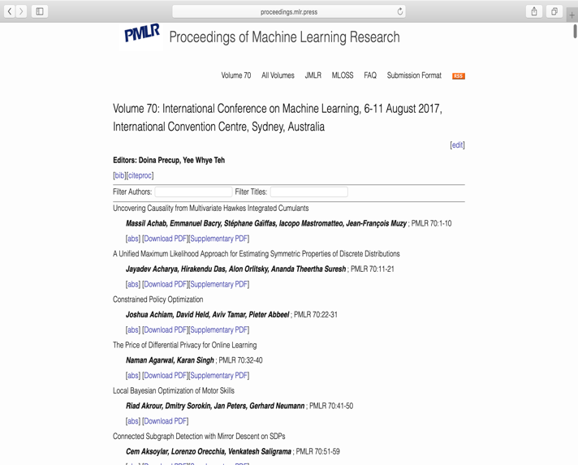

데이터 구조
ICML(Internasional Conference on Machine Learning)
ICML_Paper_Name <- xpathSApply(doc = html.parsed, path = "//div/div/div/p[1]", fun = xmlValue)
ICML_Paper_Name <- ICML_Paper_Name[-1]
ICML_Paper_Name <- gsub(pattern = "[[:punct:]]", replacement = " ", ICML_Paper_Name)
save(ICML_Paper_Name, file = "ICML_Paper_Name.RData")

Slide 23
데이터 구조
<div class="paper">
<p class="title">Improved Variational Autoencoders for Text Modeling using Dilated Convolutions</p>
<p class="details">
<span class="authors">
Zichao Yang,
Zhiting Hu,
Ruslan Salakhutdinov,
Taylor Berg-Kirkpatrick
</span>;
<span class="info">PMLR 70:3881-3890</span>
</p>
<p class="links">
[<a href="http://proceedings.mlr.press/v70/yang17d.html">abs</a>]
[<a href="http://proceedings.mlr.press/v70/yang17d/yang17d.pdf" target="_blank" onclick="ga('send', 'event', 'PDF Downloads', 'Download', http://proceedings.mlr.press/v70/yang17d/yang17d.pdf, 10);">Download PDF</a>][<a href="http://proceedings.mlr.press/v70/yang17d/yang17d-supp.pdf" target="_blank" onclick="ga('send', 'event', 'Extra Downloads', 'Download', 'Supplementary PDF', 12);">Supplementary PDF</a>]
</p>
</div>
추출 및 처리 결과
[1] "Uncovering Causality from Multivariate Hawkes Integrated Cumulants"
[2] "A Unified Maximum Likelihood Approach for Estimating Symmetric Properties of Discrete Distributions"
[3] "Constrained Policy Optimization"
[4] "The Price of Differential Privacy for Online Learning"
[5] "Local Bayesian Optimization of Motor Skills"
[6] "Connected Subgraph Detection with Mirror Descent on SDPs"
[7] "Learning from Clinical Judgments Semi Markov Modulated Marked Hawkes Processes for Risk Prognosis"
[8] "A Semismooth Newton Method for Fast Generic Convex Programming"
ICML(Internasional Conference on Machine Learning)
ICML_Paper_Name <- xpathSApply(doc = html.parsed, path = "//div/div/div/p[1]", fun = xmlValue)
ICML_Paper_Name <- ICML_Paper_Name[-1]
ICML_Paper_Name <- gsub(pattern = "[[:punct:]]", replacement = " ", ICML_Paper_Name)
save(ICML_Paper_Name, file = "ICML_Paper_Name.RData")

Slide 24
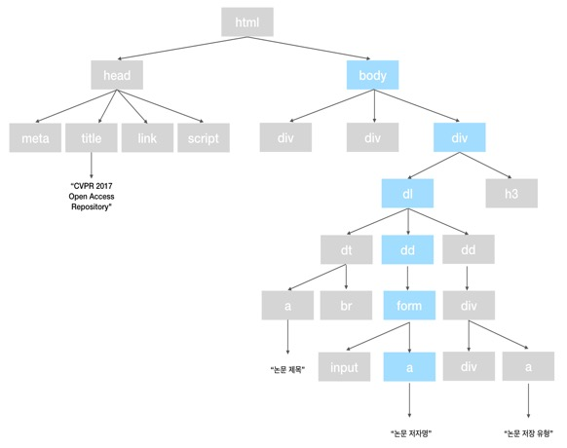
데이터 구조
ICML(Internasional Conference on Machine Learning)
ICML_Writer <- xpathSApply(doc = html.parsed, path = "//div/div/div/p/span[1]", fun = xmlValue)
ICML_Writer <- gsub(pattern = "\n", replacement = "", x = ICML_Writer)
ICML_Writer <- gsub(pattern = " ", replacement = "", x = ICML_Writer)
ICML_Writer <- strsplit(x = ICML_Writer, split = ", ")
save(ICML_Writer, file = "ICML_Writer.RData")

Slide 25
데이터 구조
[1] "http://proceedings.mlr.press/v70/achab17a/achab17a.pdf"
[2] "_blank"
[3] "ga('send', 'event', 'PDF Downloads', 'Download', http://proceedings.mlr.press/v70/achab17a/achab17a.pdf, 10);"
[4] "http://proceedings.mlr.press/v70/acharya17a/acharya17a.pdf"
[5] "_blank"
[6] "ga('send', 'event', 'PDF Downloads', 'Download', http://proceedings.mlr.press/v70/acharya17a/acharya17a.pdf, 10);"
[7] "http://proceedings.mlr.press/v70/achiam17a/achiam17a.pdf"
[8] "_blank"
[9] "ga('send', 'event', 'PDF Downloads', 'Download', http://proceedings.mlr.press/v70/achiam17a/achiam17a.pdf, 10);"
[10] "http://proceedings.mlr.press/v70/agarwal17a/agarwal17a.pdf"
[11] "_blank"
[12] "ga('send', 'event', 'PDF Downloads', 'Download', http://proceedings.mlr.press/v70/agarwal17a/agarwal17a.pdf, 10);"
[13] "http://proceedings.mlr.press/v70/akrour17a/akrour17a.pdf"
[14] "_blank"
[15] "ga('send', 'event', 'PDF Downloads', 'Download', http://proceedings.mlr.press/v70/akrour17a/akrour17a.pdf, 10);"
[16] "http://proceedings.mlr.press/v70/aksoylar17a/aksoylar17a.pdf"
추출 및 처리 결과
[1] "http://proceedings.mlr.press/v70/achab17a/achab17a.pdf"
[2] "http://proceedings.mlr.press/v70/acharya17a/acharya17a.pdf"
[3] "http://proceedings.mlr.press/v70/achiam17a/achiam17a.pdf"
[4] "http://proceedings.mlr.press/v70/agarwal17a/agarwal17a.pdf"
[5] "http://proceedings.mlr.press/v70/akrour17a/akrour17a.pdf"
[6] "http://proceedings.mlr.press/v70/aksoylar17a/aksoylar17a.pdf"
[7] "http://proceedings.mlr.press/v70/alaa17a/alaa17a.pdf"
[8] "http://proceedings.mlr.press/v70/ali17a/ali17a.pdf"
[9] "http://proceedings.mlr.press/v70/allamanis17a/allamanis17a.pdf"
[10] "http://proceedings.mlr.press/v70/allen-zhu17a/allen-zhu17a.pdf"
ICML(Internasional Conference on Machine Learning)
ICML_Writer <- xpathSApply(doc = html.parsed, path = "//div/div/div/p/span[1]", fun = xmlValue)
ICML_Writer <- gsub(pattern = "\n", replacement = "", x = ICML_Writer)
ICML_Writer <- gsub(pattern = " ", replacement = "", x = ICML_Writer)
ICML_Writer <- strsplit(x = ICML_Writer, split = ", ")
save(ICML_Writer, file = "ICML_Writer.RData")

Slide 26
데이터 시각화
논문 제목의 단어에 대한 빈도수 및 WordCloud
Name_Frequency <- function(x){
data <- gsub(pattern = "[[:digit:]]", replacement = "", x = x)
data <- gsub(pattern = "[[:punct:]]", replacement = "", x = data)
data <- tolower(data)
for (i in (1:length(data))){
temp = paste(data[i], data[i + 1])
data[i+1] = temp}
if(!require("tm")) install.packages("tm") ; library(tm)
corpus <- VCorpus(VectorSource(temp)) # Corpus in memory
result <- tm_map(corpus, removeWords, stopwords(kind = "en")) # remove stopwords [type = "English"]
result <- as.character(result[[1]])
return(result)
}
[[:digit:]] 정규 표현식을 이용하여 숫자 제거
[[:punct:]] 정규 표현식을 이용하여 문장부호 제거
Tolower를 이용하여 소문자 통일
For 반복문을 이용하여, 여러 개의 논문 제목을 1개의 벡터로 표현
Tm (Text Mining) 패키지를 이용하여 영여 불용어 제거
결과값 반환
스크레이핑 한 제목들에 대해 공통으로 처리하기 위해
Name_Frequency 함수 구현

Slide 27
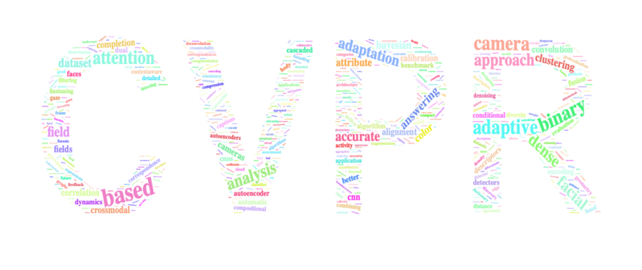
데이터 시각화
논문 제목의 단어에 대한 빈도수 및 WordCloud
# CVPR
result <- Name_Frequency(CVPR_Paper_Name)
sort(table(strsplit(x = result, split = " ")), decreasing = TRUE)[1:20]
if(!require("wordcloud2")) install.packages("wordcloud2") ; library(wordcloud2)
letterCloud(table(strsplit(x = result, split = " ")), word = "CVPR", size = 20, color = 'random-light', backgroundColor = 'White')
”” | 1198 | Detection | 54
Learning | 141 | Object | 52
Deep | 126 | Visual | 51
Networks | 102 | Segmentation | 47
Image | 92 | semantic | 47
D | 70 | Convolutional | 46
Network | 66 | Via | 42
Neural | 57 | Video | 39
Recognition | 57 | Estimation | 34
Using | 56 | Action | 32

Slide 28
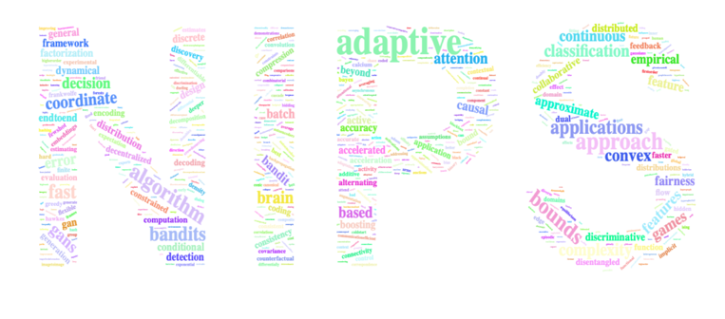
데이터 시각화
논문 제목의 단어에 대한 빈도수 및 WordCloud
# NIPS
result <- Name_Frequency(NIPS_Paper_Name)
sort(table(strsplit(x = result, split = " ")), decreasing = TRUE)[1:20]
letterCloud(table(strsplit(x = result, split = " ")), word = "NIPS", size = 20, color = 'random-light', backgroundColor = 'White')
”” | 978 | gradient | 26
learning | 179 | model | 26
networks | 67 | adversarial | 25
neural | 64 | inference | 25
deep | 61 | stochastic | 25
models | 41 | algorithms | 24
via | 32 | reinforcement | 24
data | 31 | using | 24
optimization | 29 | variational | 22
online | 27 | analysis | 21

Slide 29
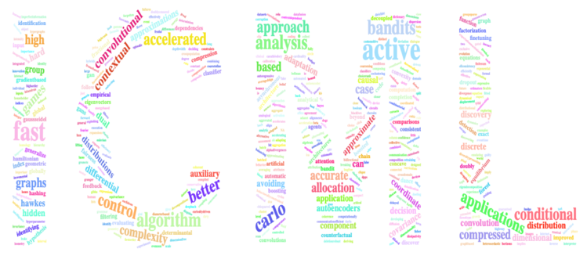
데이터 시각화
논문 제목의 단어에 대한 빈도수 및 WordCloud
# ICML
result <- Name_Frequency(ICML_Paper_Name)
sort(table(strsplit(x = result, split = " ")), decreasing = TRUE)[1:20]
letterCloud(table(strsplit(x = result, split = " ")), word = "ICML", size = 20, color = 'random-light', backgroundColor = 'White')
”” | 627 | via | 19
learning | 106 | bayesian | 18
networks | 52 | online | 18
deep | 40 | data | 17
neural | 40 | efficient | 15
models | 35 | clustering | 14
optimization | 29 | distributed | 13
stochastic | 23 | estimation | 13
gradient | 22 | inference | 13
reinforcement | 21 | using | 13

Slide 30
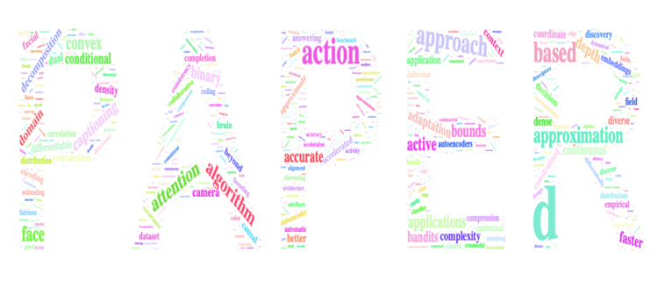
데이터 시각화
논문 제목의 단어에 대한 빈도수 및 WordCloud
# ALL
all <- paste(Name_Frequency(CVPR_Paper_Name), Name_Frequency(NIPS_Paper_Name), Name_Frequency(ICML_Paper_Name))
sort(table(strsplit(x = all, split = " ")), decreasing = TRUE)[1:20]
letterCloud(table(strsplit(x = all, split = " ")), word = "PAPER", size = 20, color = 'random-light', backgroundColor = 'White')
”” | 2803 | d | 73
learning | 426 | optimization | 69
deep | 227 | data | 67
networks | 221 | estimation | 67
neural | 161 | recognition | 65
image | 108 | visual | 63
models | 96 | Detection | 61
using | 93 | convolutional | 59
via | 93 | object | 56
network | 89 | online | 55

Slide 31
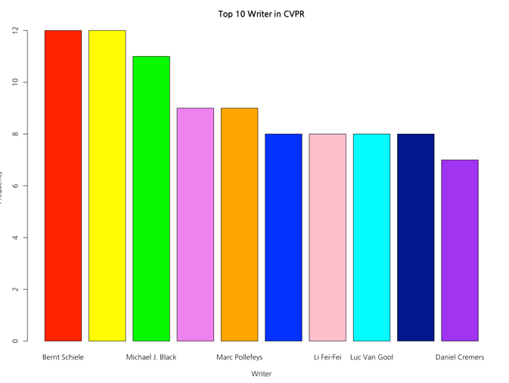
데이터 시각화
논문 저자들의 집필한 논문 개수에 대한 Barplot
# CVPR
colors<- c("red", "yellow", "green", "violet",
"orange", "blue", "pink", "cyan", "darkblue", "purple")
data <- data.frame(sort(table(unlist(CVPR_Writer)), decreasing = TRUE)[1:10]) ; data
barplot(data$Freq, names.arg = data$Var1, xlab = "Writer", ylab = "Frequency", main = "Top 10 Writer in CVPR", border = "black", col = colors)
Bernt Schiele | 12
Xiaogang Wang | 12
Michael J. Black | 11
Jiashi Feng | 9
Marc Pollefeys | 9
Abbinav Gupta | 8
Li Fei-Fei | 8
Luc Van Gool | 8
Philip H. S. Torr | 8
Daniel Cremers | 7

Slide 32
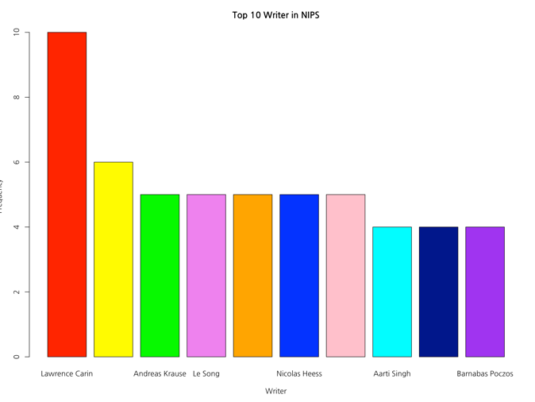
데이터 시각화
논문 저자들의 집필한 논문 개수에 대한 Barplot
# NIPS
data <- data.frame(sort(table(unlist(NIPS_Writer)), decreasing = TRUE)[1:10]) ; data
barplot(data$Freq, names.arg = data$Var1, xlab = "Writer", ylab = "Frequency", main = "Top 10 Writer in NIPS", border = "black", col = colors)
Lawrence Carin | 10
Alexander Schwing | 6
Andreas Krause | 5
Le Song | 5
Michael I. Jordan | 5
Nicolas Heess | 5
Razvan Pascanu | 5
Aarti Singh | 4
Andrew G. Wilson | 4
Barnabas Poczos | 4

Slide 33
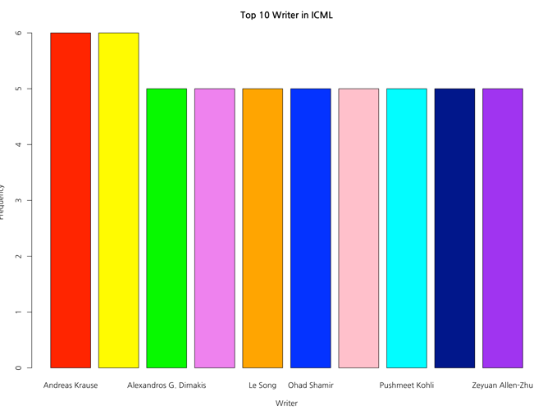
데이터 시각화
논문 저자들의 집필한 논문 개수에 대한 Barplot
# ICML
data <- data.frame(sort(table(unlist(strsplit(unlist(ICML_Writer), split = ", "))), decreasing = TRUE)[1:10]) ; data
barplot(data$Freq, names.arg = data$Var1, xlab = "Writer", ylab = "Frequency", main = "Top 10 Writer in ICML", border = "black", col = colors)
Andreas Krause | 6
Zoubin Gharamani | 6
Alexandros G. Dimakis | 5
Koray Kavukcuoglu. | 5
Le Song | 5
Ohad Shamir | 5
Oriol Vinyals | 5
Pushmeet Kohil | 5
Yuanzhi Li | 5
Zeyuan Aallen-Zhu | 5

Slide 34
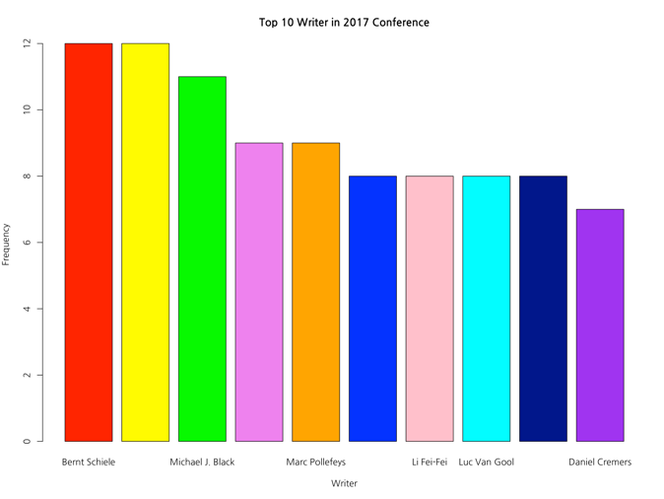
데이터 시각화
논문 저자들의 집필한 논문 개수에 대한 Barplot
# ALL
all <- unlist(CVPR_Writer, NIPS_Writer, strsplit(unlist(ICML_Writer), split = ", "))
data <- data.frame(sort(table(all), decreasing = TRUE)[1:10]) ; data
barplot(data$Freq, names.arg = data$all, xlab = "Writer", ylab = "Frequency", main = "Top 10 Writer in 2017 Conference", border = "black", col = colors)
Bernt Schiele | 12
Xiaogang Wang | 12
Michael J.Black | 11
Jiashi Feng | 9
Marc Pollefevs | 9
Abhinav Gupta | 8
Li Fei-Fei | 8
Luc Van Gool | 8
Philip H. S. Torr | 8
Daniel Cremers | 7

Slide 35
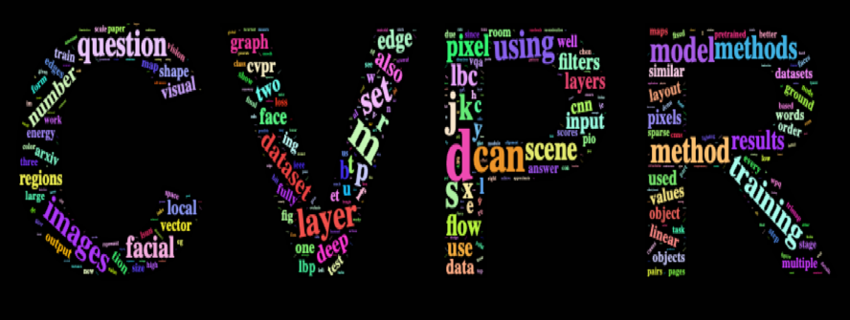
데이터 시각화
논문 내용의 단어에 대한 빈도 수 및 WordCloud
# CVPR
CVPR_Word_After[1:20]
letterCloud(CVPR_Word_After, word = "CVPR", size = 20, color = 'random-light', backgroundColor = 'black')
“” | 9803 | Layer | 76
Image | 140 | set | 73
D | 138 | using | 73
weights | 104 | information | 70
m | 100 | method | 69
s | 96 | model | 69
can | 95 | question | 69
network | 92 | training | 69
convolutional | 89 | images | 68
j | 89 | k | 67

Slide 36
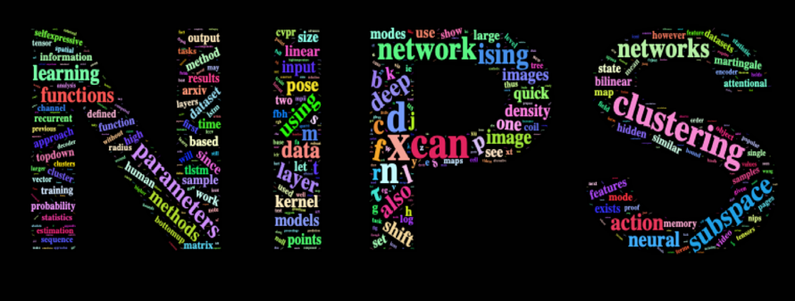
데이터 시각화
논문 내용의 단어에 대한 빈도 수 및 WordCloud
# NIPS
NIPS_Word_After[1:20]
letterCloud(NIPS_Word_After, word = "NIPS", size = 20, color = 'random-light', backgroundColor = 'black')
“” | 9871 | ising | 75
model | 146 | subspace | 74
x | 135 | c | 71
can | 114 | networks | 69
d | 109 | deep | 67
attention | 108 | l | 66
n | 102 | parameters | 66
clusteering | 97 | also | 64
network | 81 | T | 64
f | 80 | p | 61

Slide 37
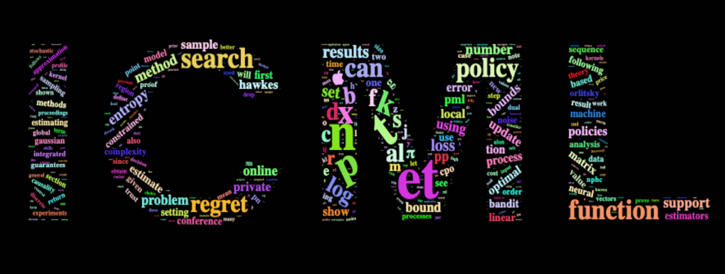
데이터 시각화
논문 내용의 단어에 대한 빈도 수 및 WordCloud
# ICML
ICML_Word_After[1:20]
letterCloud(ICML_Word_After, word = "ICML", size = 20, color = 'random-light', backgroundColor = 'black')
“” | 9873 | k | 95
et | 182 | search | 87
n | 165 | function | 86
t | 163 | can | 85
algorithm | 141 | policy | 83
p | 127 | al | 80
learning | 124 | d | 78
optimization | 121 | s | 76
x | 105 | f | 74
distribution | 95 | regret | 74

Slide 38
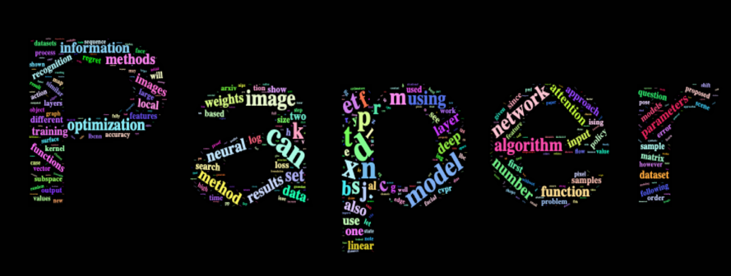
데이터 시각화
논문 내용의 단어에 대한 빈도 수 및 WordCloud
# ALL
all <- paste(CVPR_Paper_Contents, NIPS_Paper_Contents, ICML_Paper_Contents)
all <- Name_Frequency(all)
all <- sort(table(strsplit(x = all, split = " ")), decreasing = TRUE) ; all[1:20]
letterCloud(all, word = "Paper", size = 20, color = 'random-light', backgroundColor = 'black')
“” | 29547 | s | 217
d | 325 | k | 208
2x | 297 | m | 205
can | 294 | f | 195
n | 290 | image | 193
t | 261 | j | 186
p | 248 | network | 186
model | 244 | c | 184
learning | 237 | b | 181
et | 225 | r | 180

Slide 39
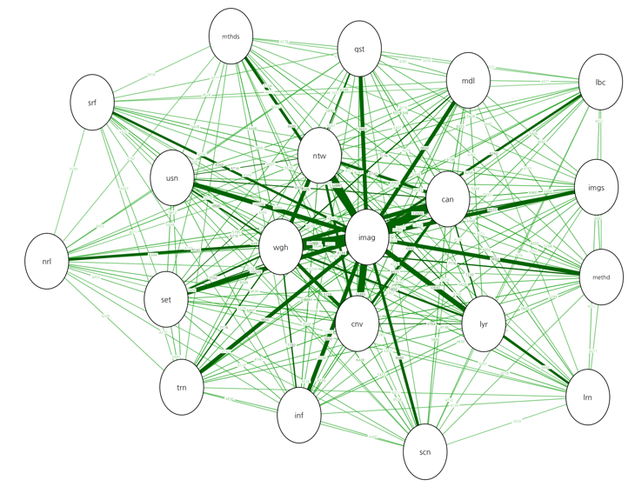
데이터 시각화
논문 내용의. 단어에 대한 관계 그래프
# Word Relationship
if(!require("statnet.common")) install.packages("statnet.common") ; library(statnet.common)
if(!require("qgraph")) install.packages("qgraph") ; library(qgraph)
# CVPR
corpus <- Corpus(VectorSource(CVPR_Paper_Contents))
tdm <- TermDocumentMatrix(corpus)
tdm.matrix <- as.matrix(tdm)
word.count <- rowSums(tdm.matrix)
word.order <- order(word.count, decreasing=TRUE)
freq.words <- tdm.matrix[word.order[1:20], ]
co.matrix <- freq.words %*% t(freq.words)
freq.words
qgraph(co.matrix,
layout = 'spring',
diag = FALSE,
vsize = 7,
label.prop = 0.5,
edge.labels = TRUE,
edge.label.cex = 0.3,
theme = 'classic')
Image | Weights | Can | Network | Convolutional | Layer | Set | Using | Information | method
140 | 104 | 95 | 92 | 89 | 76 | 73 | 73 | 70 | 69
Model | Question | Training | Images | Methods | Scene | Neural | Ibcnn | Learning | surface
69 | 69 | 69 | 68 | 62 | 62 | 61 | 59 | 59 | 59

Slide 40
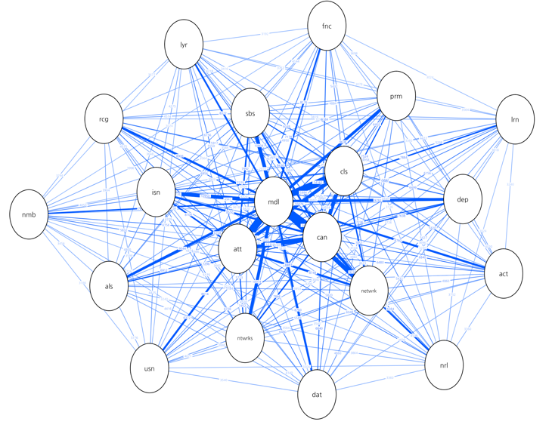
데이터 시각화
논문 내용의. 단어에 대한 관계 그래프
# NIPS
corpus <- Corpus(VectorSource(NIPS_Paper_Contents))
tdm <- TermDocumentMatrix(corpus)
tdm.matrix <- as.matrix(tdm)
word.count <- rowSums(tdm.matrix)
word.order <- order(word.count, decreasing=TRUE)
freq.words <- tdm.matrix[word.order[1:20], ]
co.matrix <- freq.words %*% t(freq.words)
freq.words
qgraph(co.matrix,
layout = 'spring',
diag = FALSE,
vsize = 7,
label.prop = 0.5,
edge.labels = TRUE,
edge.label.cex = 0.3,
theme = 'Hollywood')
Model | Can | Attention | Clustering | Network | Ising | Subspace | Networks | Deep | Parameters
146 | 114 | 108 | 97 | 81 | 75 | 74 | 69 | 67 | 66
Also | Recognition | Action | Data | Using | Layer | Functions | neural | Learning | number
64 | 61 | 60 | 60 | 59 | 57 | 56 | 56 | 54 | 54

Slide 41
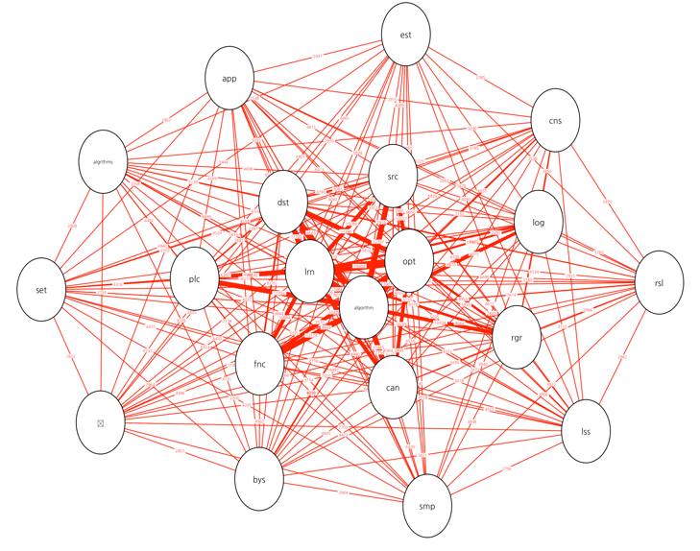
데이터 시각화
논문 내용의. 단어에 대한 관계 그래프
# ICML
corpus <- Corpus(VectorSource(ICML_Paper_Contents))
tdm <- TermDocumentMatrix(corpus)
tdm.matrix <- as.matrix(tdm)
word.count <- rowSums(tdm.matrix)
word.order <- order(word.count, decreasing=TRUE)
freq.words <- tdm.matrix[word.order[1:20], ]
co.matrix <- freq.words %*% t(freq.words)
freq.words
qgraph(co.matrix,
layout = 'spring',
diag = FALSE,
vsize = 7,
label.prop = 0.5,
edge.labels = TRUE,
edge.label.cex = 0.3,
theme = 'gimme')
Algorithm | Learning | Optimization | Distribution | Search | Function | Can | Policy | Regret | Log
141 | 124 | 121 | 95 | 87 | 86 | 85 | 83 | 74 | 70
Bayesian | Constraint | Algorithms | Results | Approach | Loss | Samples | Set | O | estimator
57 | 55 | 54 | 54 | 53 | 53 | 52 | 52 | 51 | 47

Slide 42
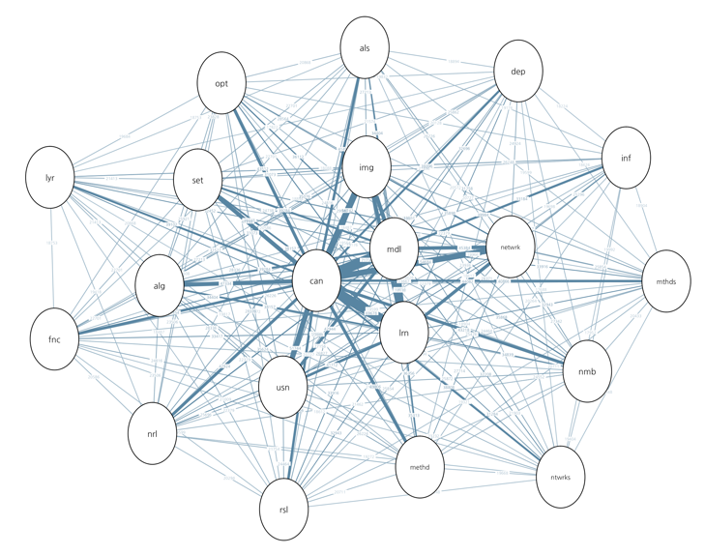
데이터 시각화
논문 내용의. 단어에 대한 관계 그래프
# ALL
Contents <- paste(CVPR_Paper_Contents, NIPS_Paper_Contents, ICML_Paper_Contents)
corpus <- Corpus(VectorSource(Contents))
tdm <- TermDocumentMatrix(corpus)
tdm.matrix <- as.matrix(tdm)
word.count <- rowSums(tdm.matrix)
word.order <- order(word.count, decreasing=TRUE)
freq.words <- tdm.matrix[word.order[1:20], ]
co.matrix <- freq.words %*% t(freq.words)
freq.words
qgraph(co.matrix,
layout = 'spring',
diag = FALSE,
vsize = 7,
label.prop = 0.5,
edge.labels = TRUE,
edge.label.cex = 0.3,
theme = 'TeamFortress')
Can | Model | Learning | Image | Network | Using | Algorithm | Set | Method | Optimization
294 | 244 | 237 | 193 | 186 | 176 | 161 | 161 | 149 | 148
Number | Neural | Also | Function | Methods | Results | Information | Deep | Layer | Networks
147 | 146 | 141 | 141 | 139 | 139 | 136 | 134 | 133 | 132

Slide 43
결론
결과에 대한 해석

Slide 44
결과 해석
CVPR Conference (783)
NIPS Conference (679)
ICML Conference (434)
Image, weights,
Network, Convolutional
Deep, Optimization,
Attention, Clustering
Algorithms, Optimization,
Distribution, Stochastic
Deep Learning, Neural Network,
Optimization, Gradient, models

Slide 45
질의응답

Slide 46
감사합니다

